Slide 1
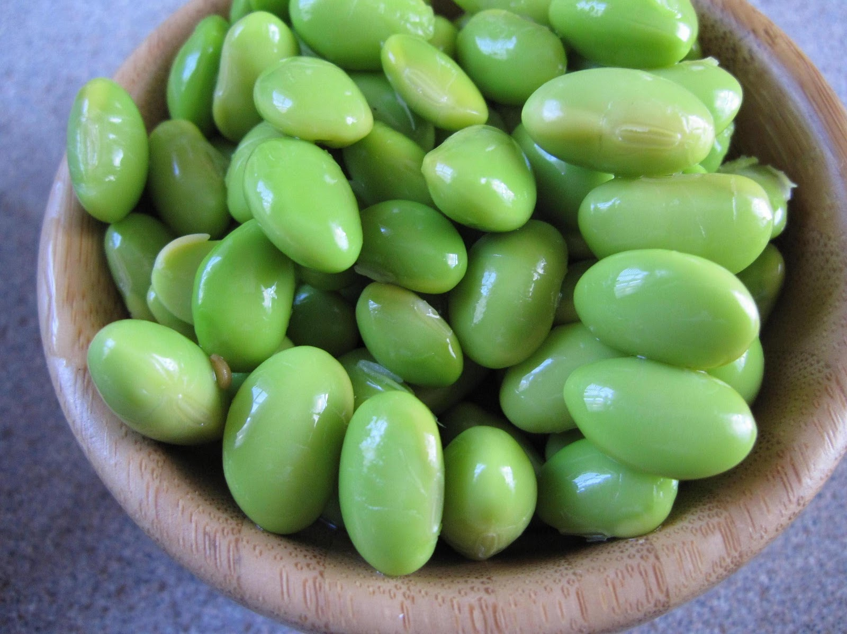
Explorations in Data Analyses for Metagenomic Advances in Microbial Ecology
20 June – 01 July 2015
Kellogg Biological Station
Michigan State University

Slide 2
Review
Microbial communities are local assemblages of microorganisms that interact with each other or with their environment
“OTUs” – operational taxonomic units – as a microbial species definition (97% identity 16S rRNA)
There are lots of choices for analyzing high-throughput sequencing data – choice of seq. platform, primers, variable region; depth of sampling; analysis methods – most of these can be reasonably informed by the community of interest, the scientific question, and the experiment design

Slide 3
Questions from yesterday?
?

Slide 4
Ju and Zhang 2015 Applied Microbiology Technology

Slide 5
Intro to amplicon sequence analysis
Merging paired-end Illumina Reads
QIIME:
picking OTUs
assigning taxonomy to OTUs
building phylogenetic tree
Removing chimeras
Building an “even” OTU table : equal No. sequences per sample
Calculating within-sample (alpha) diversity

Slide 6
Diversity part 1
What is diversity anyway?
The advantage of phylogenetic information
Rarefaction
What does a community look like, data-style?
A note on the .biom v. OTU table format
A note on naming conventions
Intro to python scripting

Slide 7
Diversity in all of its glory
“Diversity” is a vague word. In ecology, it has there are many types of diversity (e.g., alpha, beta, gamma), and there are many components to that contribute to those types.
Alpha diversity refers to the diversity inherently descriptive of one sample.

Slide 8
Whittaker introduces alpha, beta, gamma diversity (1972)

Slide 9
The confusion continues… for decades
Ecology Letters 2011
Oecologia 2010

Slide 10
Within-sample (aka alpha) diversity
Within-sample diversity includes:
Richness (number of taxa)
Evenness (distribution of the abundances of taxa)
Phylogenetic diversity (breadth of phylogenetic representation)
*Composition (who’s there – identity of the taxa)
Combinations of the above components are used to calculate other diversities: Shannon diversity, Simpson, etc.

Slide 11
Within-sample diversity
Information about the community that we can glean from metagenomic sequencing
A certain number of OTUs- richness
Each OTU is present in a certain abundance- collectively, evenness
Each OTU has a taxonomic assignment- composition
C₆H₁₂O₆
CH₄
CO₂
CO₂
C₂H₃O₂⁻
Acyl-HSL
O₂
HPO₄²⁻
NH₄⁺
H₂
NO₃⁻
N₂
MeS
SO₄²⁻
HS⁻
Me²⁺

Slide 12
Richness
Richness: How many OTUs?
OTU
Richness = 11 OTUs

Slide 13
Evenness
Evenness: What is the distribution of abundances in the community?
OTU
Count:
No. seq, no. individuals (e.g., FISH), biomass, etc.
6
1
4
8
1
5
3
13
5
1
2

Slide 14
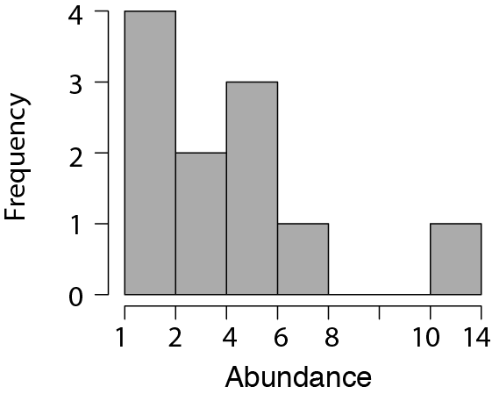
Evenness
Evenness: What is the distribution of abundances in the community?
OTU
Count:
13
8
6
5
5
4
3
2
1
1
1

Slide 15
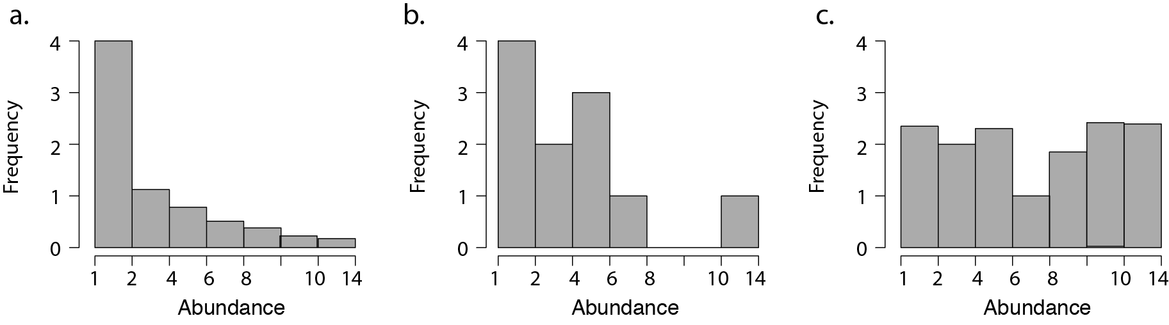
Evenness
Evenness: What is the distribution of abundances in the community?
Less even
More even
Common metric = Pielou’s evenness

Slide 16
Membership and Composition
Composition: Who is there?
OTU
Count:
13 Alpha-proteobacteria
8 Firmicutes
6 Beta-proteobacteria
5 Bacteroidetes
5 Actinobacteria
4 TM7
3 Alpha-proteobacteria
2 Gamma-protobacteria
1 Bacteroidetes
1 Bacteroidetes
1 Verrucomicrobia

Slide 17
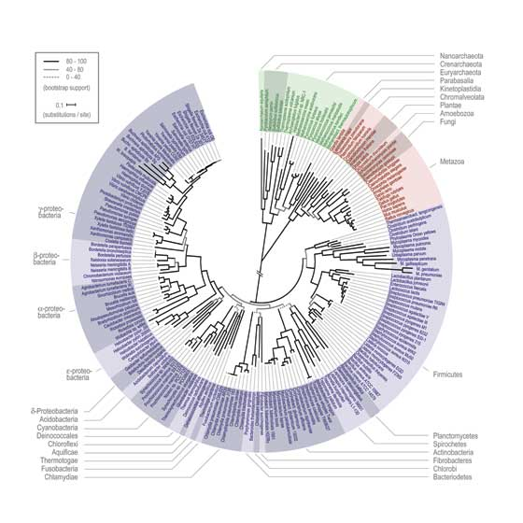
The advantages of phylogeny
Phylogenetic diversity: What is the breadth of phylogenetic representation?
OTU
Count:
Common metric =
Faith’s phylogenetic diversity
13 Alpha-proteobacteria
8 Firmicutes
6 Beta-proteobacteria
5 Bacteroidetes
5 Actinobacteria
4 TM7
3 Alpha-proteobacteria
2 Gamma-protobacteria
1 Bacteroidetes
1 Bacteroidetes
1 Verrucomicrobia

Slide 18
Subsampling exercise
Why we can’t compare samples that do not have the same number of sequences.

Slide 19
Subsampling: Get “even”
Because of sequencing artifacts and experimental design, there can be quite a range of quality sequences returned for each sample.
Sub-sampling of sequences to achieve an even number across all samples within a dataset allows for comparing diversity across samples
This is very important for being able to compare diversity across samples.
Analogy: You are a tree ecologist. Would it be reasonable to directly compare the forest diversity (assessed by counting different types of trees) in a 1x1 m plot to a 1000 x 1000 km plot? The second plot has 1000x the coverage as the first and thus the comparison is unsound.
Choose a sequencing depth that maximizes the number of samples that can be included at the most informative sequencing depth.
If you have obvious outliers in sequencing depth (e.g., the median depth is 70K and you have one sample with 1000 sequences), get rid of it and save yourself heartache.

Slide 20
What does a community look like, data-style?
“OTU table” – the original
.Biom table – more concise & faster computing for extra large datasets
New formats : biom2
See McDonald et al. 2012. “The Biological Observation Matrix…” GigaScience.

Slide 21
Kinds of Community matrix/ OTU Table
 | Soil 1 | Soil 2 | Soil 3
OTU 1 | 0 | 3000 | 23
OTU 2 | 1 | 5 | 5
OTU 3 | 20 | 100 | 100
Raw
Straight up counts*
*note: data must be subsampled to an even sequencing effort!
 | Soil 1 | Soil 2 | Soil 3
OTU 1 | 0 | 0.966 | 0.179
OTU 2 | 0.047 | 0.002 | 0.039
OTU 3 | 0.953 | 0.032 | 0.782
Relative
Percent or proportion
(Standardizes for sampling effort?
 | Soil 1 | Soil 2 | Soil 3
OTU 1 | 0 | 1 | 1
OTU 2 | 1 | 1 | 1
OTU 3 | 1 | 1 | 1
Binary
(presence/absence)

Slide 22
Information in an OTU table
Number of occurrences (per sample and for the whole dataset)
Total no. OTUs observed in the dataset
Average abundance of OTUs
Richness (no. OTUs per sample, mean, max, min, range)
Number of singletons (OTUs detected only once in a dataset)
Calculate: Diversity, Evenness (equitability of OTU abundances, including rarity and dominance)
Number of samples (communities) in your dataset
Dimensions of an OTU table: rows (taxa) x columns (samples/communities)

Slide 23
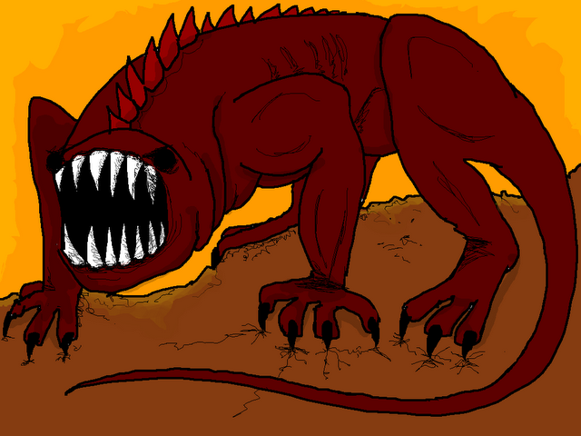
Common features of microbial OTU tables
Redundant: more than one taxa has the exact same pattern
Unknown underlying distribution
Contain many “zeros”
Many samples and OTUs; computationally large
(A beast, hyperboleandahalf.blogspot.com)

Slide 24
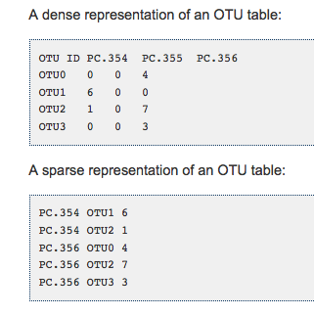
Biom formatted OTU tables
.biom format
Link:
http://biom-format.org
This is all changing very often!! Biom formats are improved, keep up with when changes are anticipated
Old-style OTU table - lots of 0’s
.biom formatted – only list present taxa

Slide 25
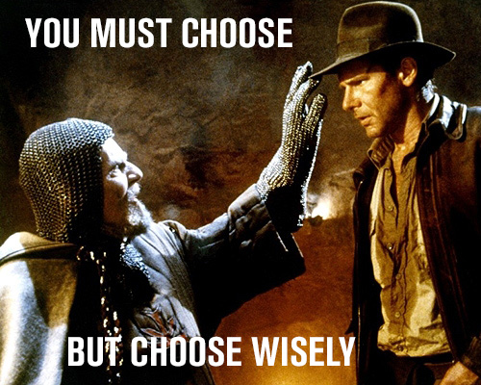
Naming Conventions
Examples of a a good name
20_A_T1_R1 (translation : subject 20, treatment A, timepoint 1, rep1 )
Examples : Bad name
Ashley’s sample
A
Ashley Loves Microbes Pool #1!
Example : kind of bad names
ALS1, ALS2, ALS3….ALS10, ALS11
Improved:
ALS01, ALS02, ALS03…ALS10, ALS11

Slide 26
A look at python syntax & common arguments in QIIME
Python script
Input file
filter_fasta.py -f rep_set_aligned.fasta -o non_chimeric_rep_set_aligned.fasta -s chimeric_seqs.txt -n
Output file
Other arguments, specific to the script
Other common QIIME arguments
-m analysis method, metric (sometimes map file)
-t tree file
-a alignment template file
-v verbose = good for troubleshooting
-h help
-f force overwrite of an existing directory

Slide 27
Tutorial: What we’re about to do
Pick OTUs : open reference
Made taxonomic assignments of our sequences: assign_taxonomy.py
Made OTU tables (biom + classic): make_otu_table.py
Made a phylogenetic tree of our representative sequences: make_phylogeny.py
Rarefied to an equal sequencing depth: alpha_rarefaction.py
Calculated & visualized alpha diversity: alpha_diversity.py, summarize_taxa_through_plots.py

Slide 28
Approaches to Picking OTUs
Reference based : percent identity to defined taxa populating in a reference database
Pros: you know the taxa are “real”!
Cons: Weird environments don’t have many representatives in databases, only as good as your database
De novo : percent identity to other sequences in the dataset; taxonomic assignment to the OTUs happens afterwards
Pros: Good for weird environments with low representation in databases
Cons: Computationally expensive, “greedy” algorithms can artificially inflate diversity
Open reference : cluster against a reference db first, and anything that doesn’t hit gets clustered de novo
Best of both worlds? Now can optimized so that new de novo OTUs are added to the original database and used subsequently in “reference” clustering
See Rideout et al. 2014 PeerJ

Slide 29
Let’s analysis!

Slide 30
Diversity Part 2

Slide 31
Diversity Part 1 Review
Within-sample diversity describes a single community/ sample, and includes metrics of richness, evenness, phylogenetic diversity, and other summative metrics of diversity.
Because sequencing success can be highly variable, rarefaction is used to ensure an even-depth of sequences across communities that will be compared.
An OTU table is the input file for community analyses. It contains information about the abundance of each OTU within every sample. OTU tables can be (classic, .txt) or (.biom) format.

Slide 32
Tutorial: what did we do?
Made taxonomic assignments of our sequences: assign_taxonomy.py
Made OTU tables (biom + classic): make_otu_table.py
Made a phylogenetic tree of our representative sequences: make_phylogeny.py
Rarefied to an equal sequencing depth: alpha_rarefaction.py
Calculated & visualized alpha diversity: alpha_diversity.py, summarize_taxa_through_plots.py

Slide 33
Questions from this morning?
?

Slide 34
Amplicon sequence analysis continued
In QIIME:
Calculating comparative (beta) diversity
Visualizing patterns of comparative diversity
Hypothesis testing: clusters and gradients
Dealing with the QIIME biom table: conversion and nuances

Slide 35
Outline: Comparative (beta) diversity
What questions can you ask about your microbial communities?
Comparative diversity
Calculating community resemblance
Visualizations: Ordinations, heatmaps, dendrograms
Gradients versus categories (clusters)
Statistical analysis of clusters: Hypothesis testing for differences in categorical groups
Statistical analysis of gradients: Linking environmental variables to changes in community structure

Slide 36
Questions about microbial communities
Summary information for each community: Within-sample (alpha) diversity
Differences between communities: Comparative (beta) diversity

Slide 37
Ask yourself: What is the purpose of the analysis?
Exploration: hypothesis generating, perfect for observational studies, includes visualizations like ordinations and clustering
Hypothesis testing: address a specific question (e.g., are there differences among treatment groups?), and usually permutation-based (non-parametric) p-value

Slide 38
What questions do you want to ask about your microbial communities?

Slide 39
Comparative diversity
Space / Time
Categories (e.g., fire-affected, recovered)
Gradients/empirical measurements (e.g., pH, temperature, chemistry)
Look forward to Stuart’s R lecture on category/gradient analyses!

Slide 40
Analysis of comparative diversity is informed by:
Associated environmental/quantitative variables*
Examples: temperature, red blood cell counts, glucose levels, dissolved oxygen, temperature, acidity, time, % mortality, etc.
Associated categorical/descriptive/qualitative variables*
Examples: treatment groups, male/female, control/treatment, age groups, before/after
* Environmental and categorical variables often are linked to samples in a single “mapping file”

Slide 41
Comparative diversity requires a measure of pair-wise community resemblance
Resemblance = distance, similarity, dissimilarity
Important decisions in choosing a resemblance metric:
Weighted v. Unweighted
Phylogenetic v. Taxonomic
All pairs of resemblances are included in a sample by sample resemblance (distance/similarity) matrix
Simplifies the data and the analysis
Choice of resemblance metric will influence the outcome of community analysis

Slide 42
Calculating resemblance: Bray-Curtis Example
d_{jk} = (sum abs(x_{ij}-x_{ik})/(sum (x_{ij}+x_{ik}))
Where d_{jk} is the Bray-Curtis index between samples j and k
and x is the (relative) abundance of taxa I
See Legendre and Legendre book: Numerical Ecology. Chapter 7: “Ecological resemblance” for a comprehensive discussion of All the Resemblances Ever.

Slide 43
Making a Resemblance Matrix
1. OTU table (usually relativized)
 | Soil 1 | Soil 2 | Soil 3
OTU 1 | 0 | 0.966 | 0.179
OTU 3 | 0.047 | 0.002 | 0.039
OTU 3 | 0.953 | 0.032 | 0.782
2. Chose appropriate resemblance (e.g., Bray Curtis, UniFrac)
 | Soil 1 | Soil 2 | Soil 3
Soil 1 | 0
Soil 2 | 0.966 | 0
Soil 3 | 0.179 | 0.787 | 0
3. Create a square (observation x observation) resemblance matrix from pair-wise comparisons.
Notes:
The purpose of a resemblence matrix is to reduce complexity in the dataset so that it can be used for hypothesis testing or exploration analyses

Slide 44
Examples of Resemblance metrics
Weighted metrics
Unweighted metrics
Phylogenetic metrics
Taxonomic metrics
Metric name Accounts for | Sørensen | Bray-Curtis | Weighted UniFrac | Unweighted UniFrac
Composition | X | X | X | X
OTU abundances? |  | X | X
Phylogenetic diversity? |  |  | X | X

Slide 45
We can compare different distance/similarity measures to deduce the most important components of community structure for the overarching patterns observed

Slide 46
Useful community visualization tools
Ordination : Calculated from community resemblance; relationships are represented by distances between symbols
Heatmap : Calculated from count/abundance data; The abundance of each taxon relative to the others depicted by color
Dendrogram: Calculated from community resemblance; similar communities fall into same cluster.

Slide 47
Visualizing communities: ordination
Legend
Treatment 1
Control
Axis 2: 6% variance explained
Axis 1: 50% variance explained
2 or 3 dimensional representation of the data
Each symbol is one community (compared by the chosen resemblance metric)
The distance between symbols represents the extent of differences between communities
First axis often explains most variance in the data, variation explained should be provided.

Slide 48
Types of ordinations
Non-metric multidimensional scaling (NMDS)
Principle coordinates analysis (PCoA)
Correspondence analysis (CA)
Avoid: Principle components analysis (PCA), Redundancy analysis (RDA) in some situations, and constrained analyses unless you really know what you are doing

Slide 49
How do we look at ordinations?
Think about: CENTROID (mean) or DISPERSION (spread, variability)
A. Different centroid, same spread
B. Different centroid, different spread
C. Same centroid, different spread

Slide 50
Visualizing communities: dendrograms
A different way of visualizing the same data
=
Legend
0%
Treatment 1
Control
Resemblance
50%
100%
Notes:
Note: cluster is not the same as phylogenetic analysis.

Slide 51
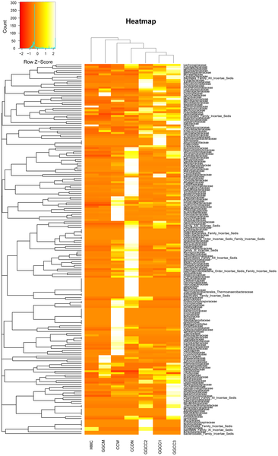

Visualizing communities: heatmaps
Figure 6. Bacterial distribution among the seven samples.
Wu S, Wang G, Angert ER, Wang W, et al. (2012) Composition, Diversity, and Origin of the Bacterial Community in Grass Carp Intestine. PLoS ONE 7(2): e30440. doi:10.1371/journal.pone.0030440
http://www.plosone.org/article/info:doi/10.1371/journal.pone.0030440

Slide 52
Discovering patterns: Clusters & Gradients
Clusters = Are groups different? (e.g., Treatment v. Control)
Also called: factors, qualitative variables
Gradients = Do communities change with known environmental changes? (e.g., over time?)
Also called: continuous, quantitative, vector variables

Slide 53
How do we interpret ordinations?
Think about: CENTROID (mean) or DISPERSION (spread, variability)
A. Different centroid, same spread
B. Different centroid, different spread
C. Same centroid, different spread

Slide 54
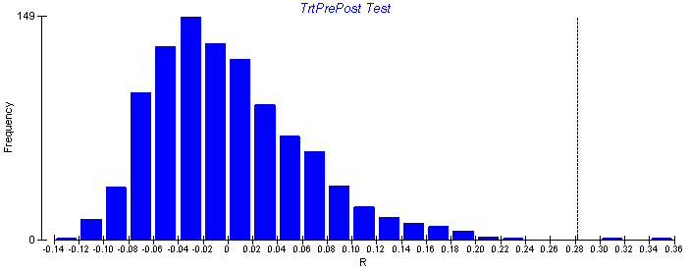
Non-parametric hypothesis tests
Non-parametric tests are used to test hypotheses of multivariate data when the underlying distribution of the data is unknown.
Non-parametric tests randomly re-sample the dataset to create a re-shuffled distribution, calculate a test statistic for each random distribution, and then ask the probably of finding the actual statistic given the random re-sampling distribution of the data.
It is important to use these tests for microbial beta diversity, as the assumptions of underlying normal distributions of most parametric tests (e.g., ANOVA) are violated.

Slide 55
Clusters: Testing for differences in a priori groups
Permutation-based analyses to test hypotheses about group differences in CENTROID (mean) or DISPERSION (spread, variability)
A. Different centroid, same spread
Test name | Centroid (mean) | Spread (variability)
PERMANOVA | X | X
MRPP | X | X
ANOSIM | X | X
PERMDISP |  | X
B. Different centroid, different spread
C. Same centroid, different spread

Slide 56
A paper where every hypothesis test is used with every resemblance. Ever.
(just kidding)
(kind of)
The methods are useful.
Shade et al. 2013 AEM

Slide 57
Gradients: Linking environmental and community data
1. Mantel Test
2. Vector fitting to ordination axis score
Community Resemblance
 | Caterpillar 1 | Caterpillar 2 | Caterpillar 3
Caterpillar 1 | 0
Caterpillar 2 | 0.966 | 0
Caterpillar 3 | 0.179 | 0.787 | 0
Pearson’s correlation
Permuted p value
Axis 2
Time
Time / environ. distance
Temperature
 | Caterpillar 1 | Caterpillar 2 | Caterpillar 3
Caterpillar 1 | 0
Caterpillar 2 | 1 | 0
Caterpillar 3 | 10 | 3 | 0
Axis 1

Slide 58
Practicalities: Getting data into R from QIIME
Biom to classic OTU table
-See end of QIIME 3 tutorial : biom convert
For importing resemblance tables
1. read.table(header=TRUE, row.names =1; sep =“\t”)
2. as.dist()

Slide 59
Let’s analysis!

